Slide 1
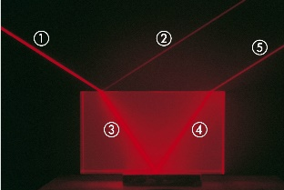
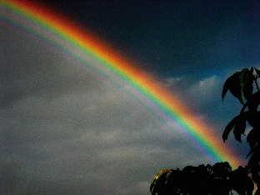
Chapter 35: The Nature of Light and the Principles of Ray Optics
Reading assignment: Chapter 35 and selections of chapter 34
Homework 35.1 (due Monday, April 22): OQ2, OQ4, OQ5, OQ6, OQ7, QQ2, 1, 2, 3, 5, 8, 12, 22, 25, 29
Homework 35.2 (due Friday, April 26): OQ9, OQ14, OQ15, QQ5, 36, 37, 39, 41, 42, 45, 65
Dual Nature of light: Wave & Particle
Energy of light (photon): $E=hf$
Light as an electromagnetic wave; speed of light in vacuum, c = 3.00·10⁸ m/s
In chapters 35 & 36 we will treat light as simple, straight, rays (good approximation when features are larger than wavelength of light, $d≫λ)$
Reflection: incident angle = reflected angle: $θ^{′}=θ$
Refraction and Snell’s law: $n_{1}sinθ_{1}=n_{2}sinθ_{2}$, index of refraction $n=\frac{c}{v}$
Huygens’s Principle (wavelets create new wave front)
Dispersion (index of refraction, n, depends on wavelength)
Total internal reflection

Slide 2
Dual Wave/Particle Nature of Light: Brief History
There was a centuries-long debate among many prominent scientists about whether light should be described as a wave or a particle (photon). It’s a tie.
Generally before 1900th century: Stream of particles (e.g. Newton), explains reflection & refraction
Though, in 1678 Huygens described light as a wave; could also explain reflection & refraction
1801: Young’s double slit experiment: light is a wave
1873: Maxwell – light is an electromagnetic wave
1887: Hertz – produced electromagnetic wave
But, photoelectric effect: When light strikes a metal surface, electrons are emitted: The kinetic energy of the emitted electrons is independent of the wave intensity (light intensity); it only depends on the frequency of the light
→ To explain this effect, Einstein proposed that light consists of photons (particles, or wave packets) with energy, $E=hf$ (or E = hν)
f, ν is frequency of light (wave!), and h = 6.63·10⁻³⁴ J·s (Planck’s constant)

Slide 3
Dual Wave/Particle Nature of Light
Light is light.
Light exhibits the characteristics of a wave in some situations (reflection, refraction, diffraction, interference, polarization). Maxwell’s wave theory of light.
Light exhibits the characteristics of a particle in other situations (photoelectric effect (chapter 40), also reflection & refraction). Light particles are called photons (concept developed by Albert Einstein, others) and have energy:
f, ν is frequency of light (wave!), and h = 6.63·10⁻³⁴ J·s (Planck’s constant)
$E=hf$ (or E = hν)
Next few chapters we’ll treat light as a wave

Slide 4
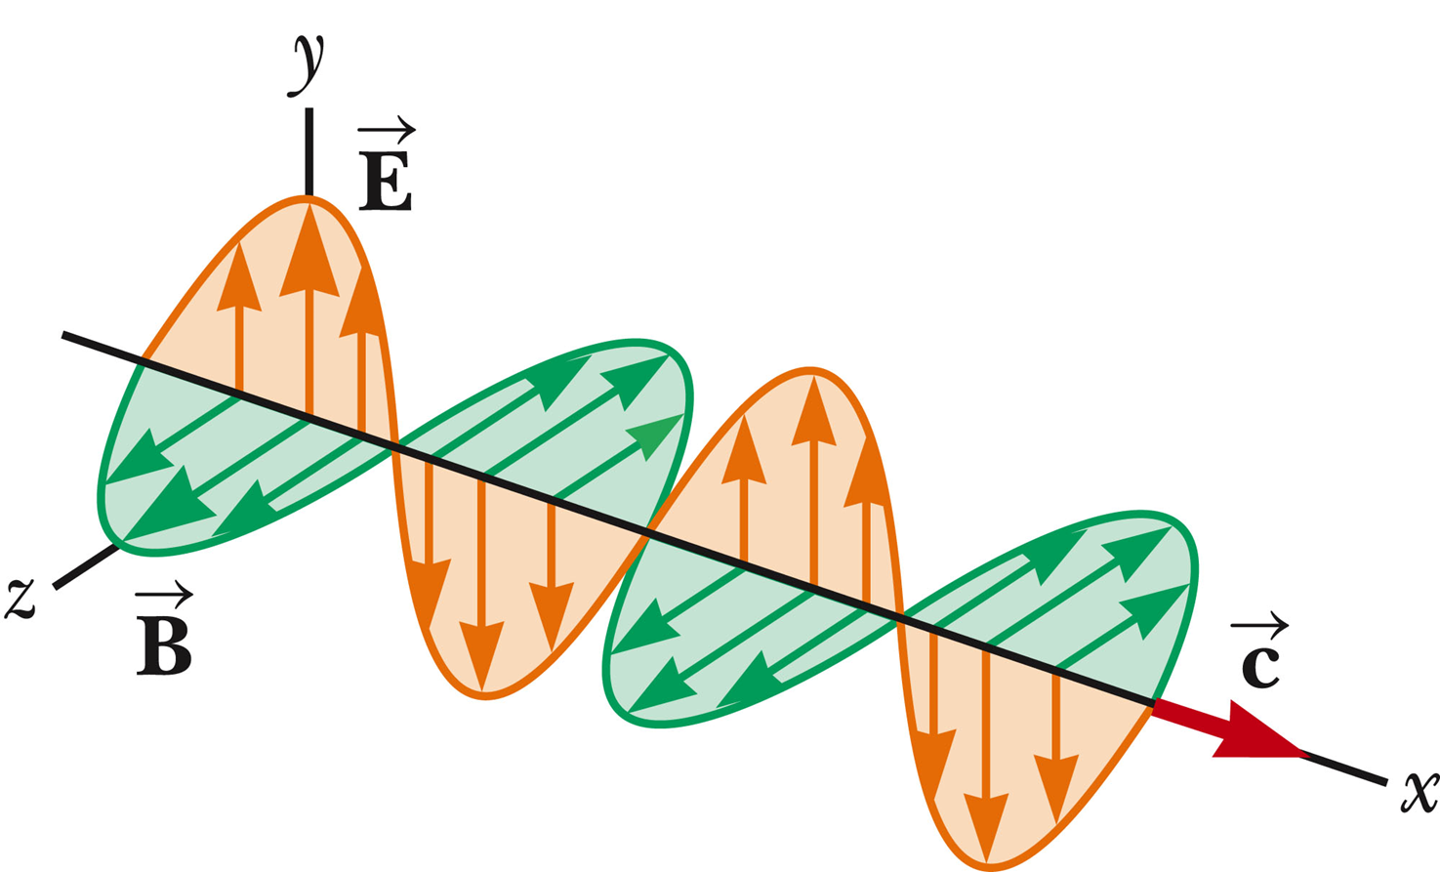
Light as an electromagnetic wave
Light is a transverse electromagnetic wave in which the propagation direction (x), E-field (y), and B-field (z) are all perpendicular to each other.
Light sources emit a large number of waves having some particular orientation of the E-field vector.
Unpolarized light: E-field vectors all point in a random direction.
Nice movie: https://www.youtube.com/watch?v=4CtnUETLIFs
Schematic depiction of light wave:

Slide 5
Basic Variables of Wave Motion
Terminology to describe waves
Snapshot of sinusoidal wave at one time point
Crest: “Highest point” of a wave
Wavelength λ: Distance from one crest to the next crest.
Wavelength λ: Distance between two identical points on a wave.
Period T: Time between the arrival of two adjacent waves (crests).
Frequency f: 1/T, number of crest that pass a given point per unit time

Slide 6
Traveling sinusoidal wave
Amplitude E₀
Here:
Propagation direction is along x, Amplitude (e.g. E-field) is along y.
For visible light (see two slides down):
Wavelength, λ, ranges from 380 nm (violet) to 750 nm (red)
Velocity is speed of light: 3.00·10⁸ m/s (in vacuum)
Frequency, f, ranges from 400·10⁸ Hz (red) to 790·10⁸ Hz (violet).

Slide 7
Understanding Directions for Waves
The wave can go in any direction you want
The electric field must be perpendicular to the wave direction
The magnetic field is perpendicular to both of them
E × B is in direction of motion
Right hand rule for electromagnetic wave propagation
e.g. Propagation (thumb), E-field (index); B-field (middle).
(or: Propagation (index), E-field (middle); B-field (thumb)).
i-clicker. A wave has an electric field given by E = j E₀ sin(kz – ωt). What does the magnetic field look like?
A) B = i (E₀/c) sin(kz - ωt) B) B = k (E₀/c) sin(kz - ωt)
C) B = - i (E₀/c) sin(kz - ωt) D) B = - k (E₀/c) sin(kz - ωt)

Slide 8
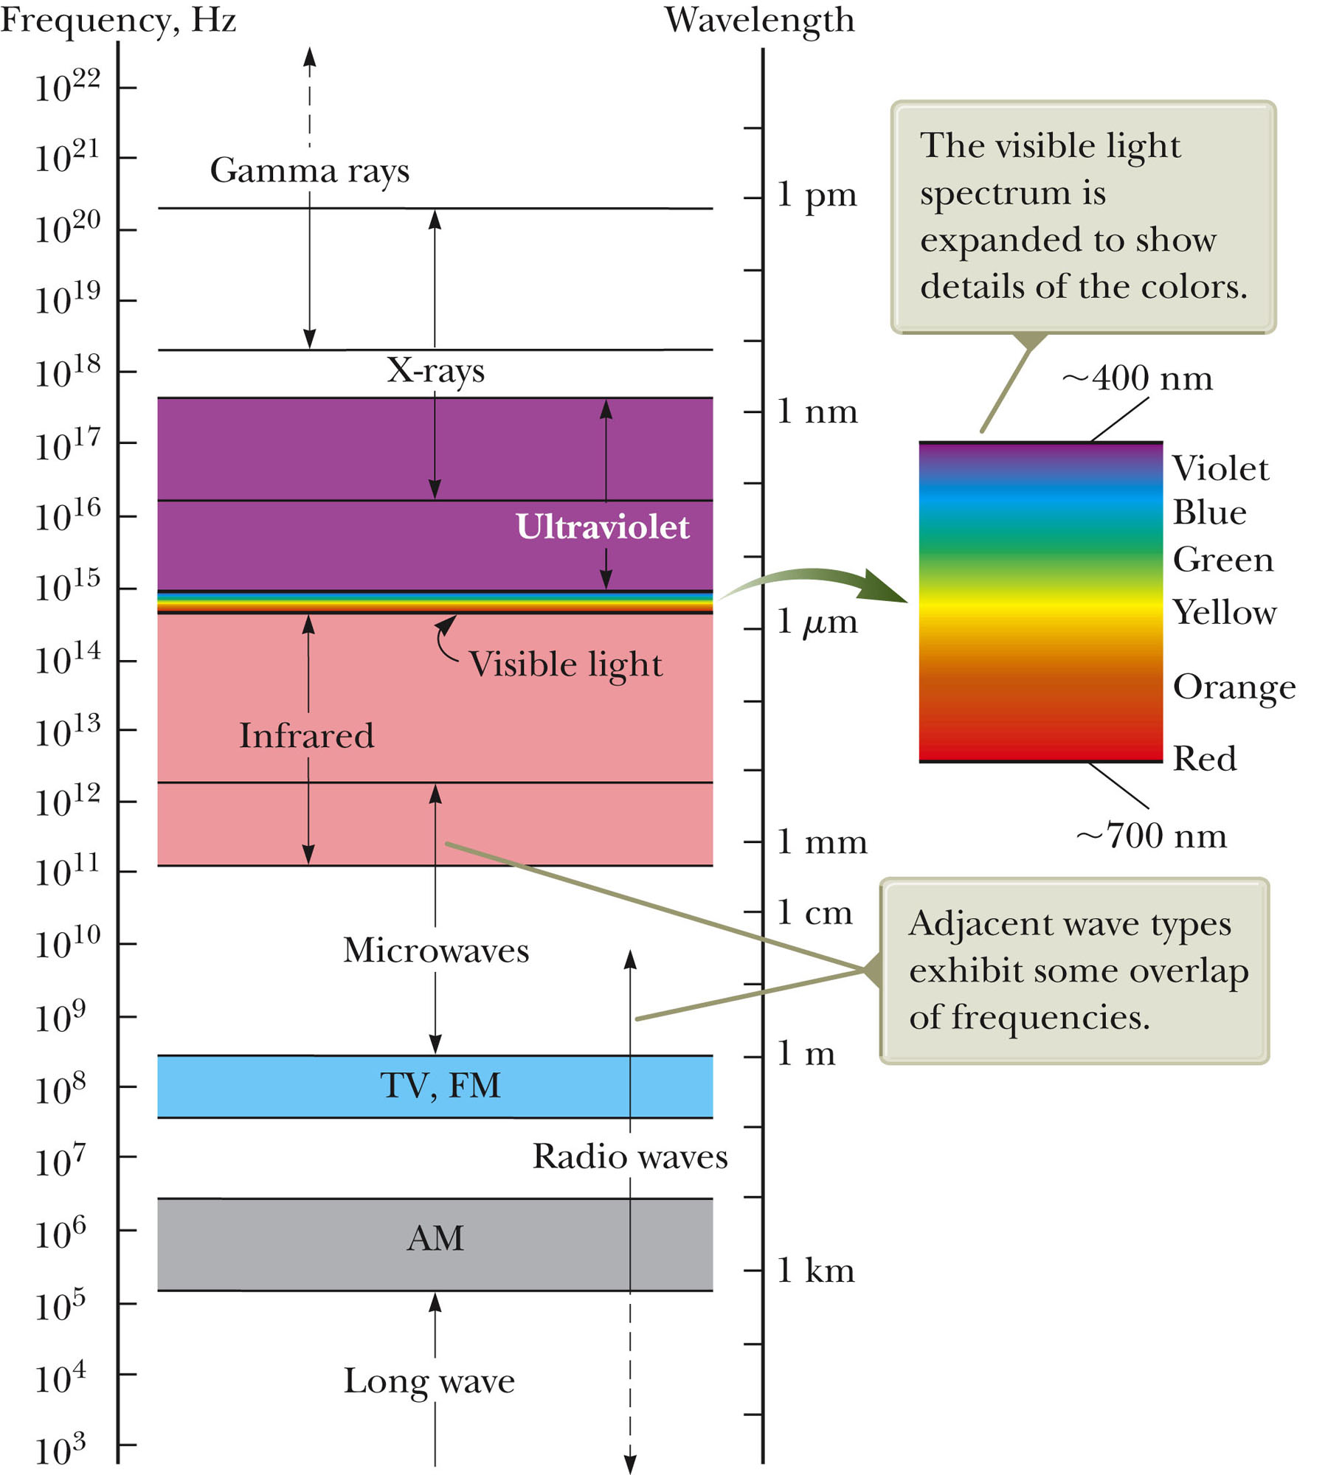
The electro-magnetic spectrum
All electromagnetic waves move with ‘speed of light’, c
I$n vacuum:$
$$c=3.00∙{10}^{8} m/s$$
$$c= λ∙f$$

Slide 9
Wavelength, frequency and energy of visible light
Color | Wavelength | Frequency | Photon energy, E = hf
violet | 380–450 nm | 668–789 THz | 2.75–3.26 eV
blue | 450–495 nm | 606–668 THz | 2.50–2.75 eV
green | 495–570 nm | 526–606 THz | 2.17–2.50 eV
yellow | 570–590 nm | 508–526 THz | 2.10–2.17 eV
orange | 590–620 nm | 484–508 THz | 2.00–2.10 eV
red | 620–750 nm | 400–484 THz | 1.65–2.00 eV
From: http://en.wikipedia.org/wiki/Visible_spectrum

Slide 10
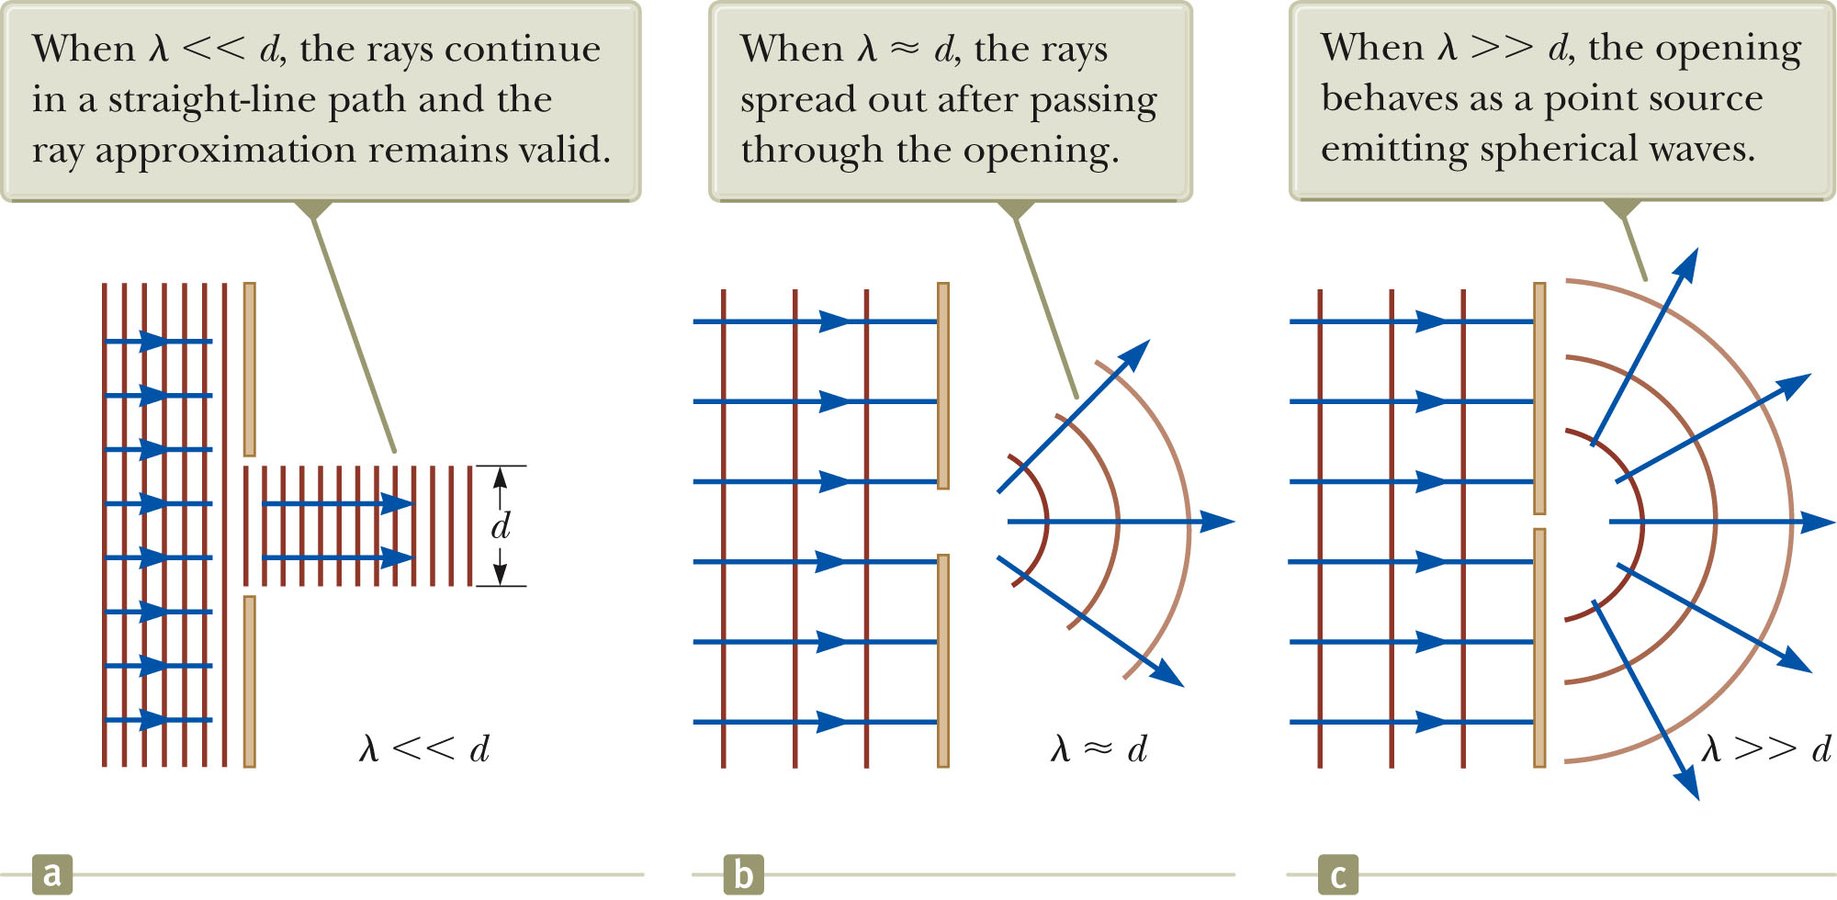
The Ray Approximation (geometric optics)
In the next two chapters, we will treat light as simple, straight rays (→ ray optics or geometric optics).
Ray approximation: The rays of a given wave are straight lines along the propagation direction, perpendicular to the wave front.
Good approximation when features are a larger than the wavelength of light; $λ≪d$.
When we see an object, light rays are coming from the object enter our eye.
When $λ≫d$, we get phenomena like diffraction and interference (chapter 37 & 38)

Slide 11
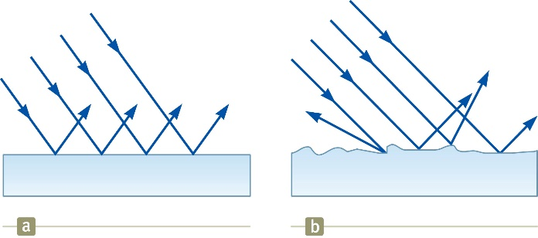
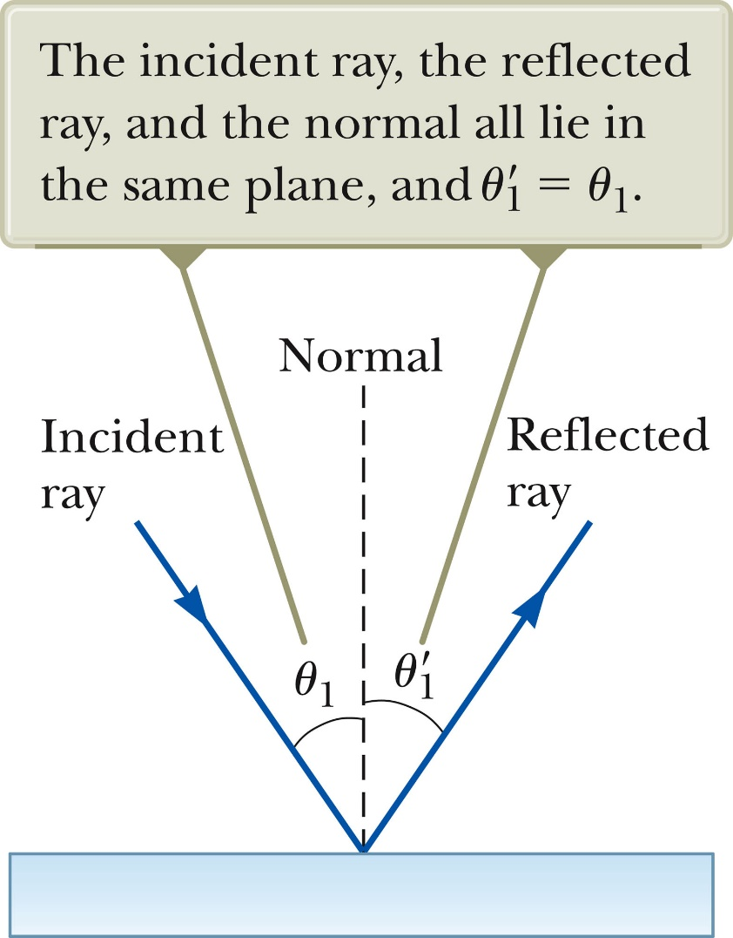
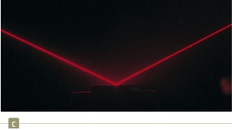
The law of reflection
Incident angle = reflected angle
Specular reflection
Diffuse reflection
$$θ_{1}=θ_{1}^{′}$$
Incident angle = reflected angle
Angle is measured with respect to normal
Subscript 1 means we are staying in the same medium

Slide 12
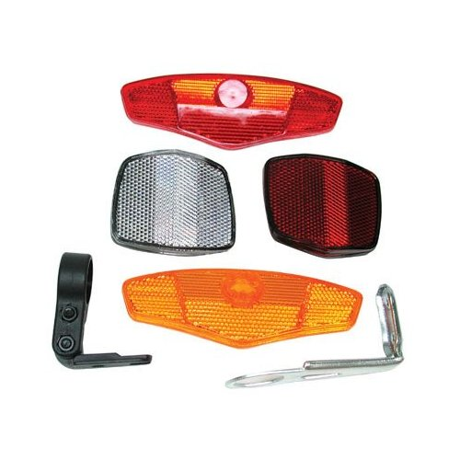
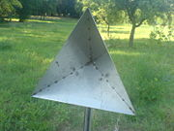
i-clicker
Retroreflector. A light ray starts from a wall at an angle of 47° compared to the wall. It then strikes two mirrors at right angles compared to each other. At what angle θ does it hit the wall again?
A) 43° B) 45° C) 47° D) 49° E) 51°
θ
= ?°
47°
47°
Mirror
47°
43°
43°
This works for any incoming angle
In 3D, you need three mirrors at right angles
Mirror
These retro-reflectors (with mirrors at 90°) are used in many situations (bicycle reflectors, car tail lights, running shoes, traffic signs, measuring distance to moon with laser)

Slide 13
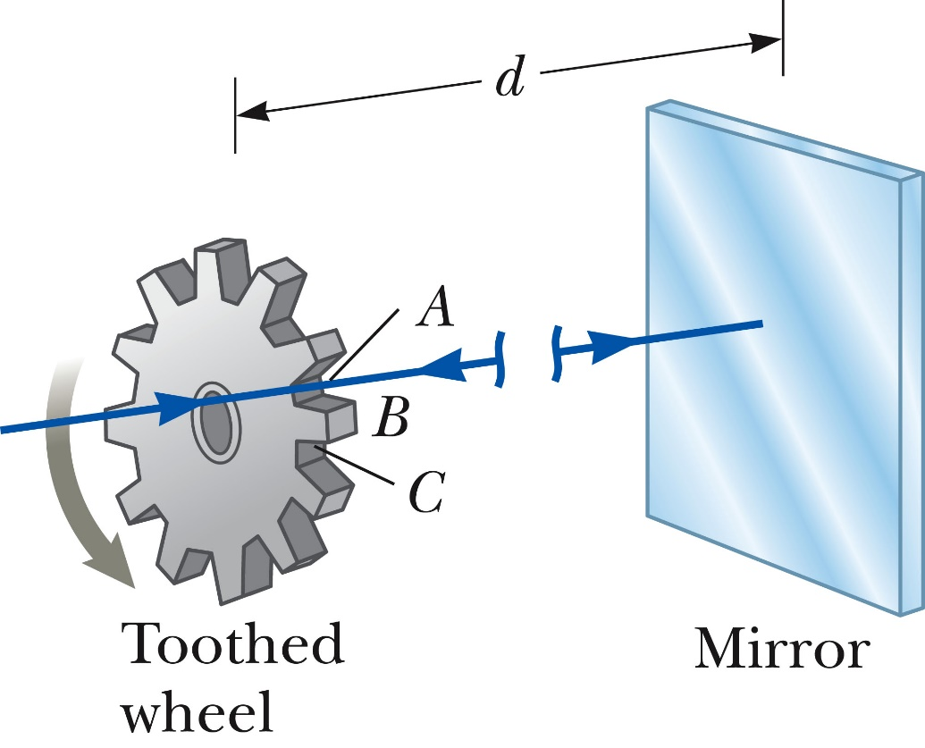
White board example: Measuring the speed of light with a Fizeau’s wheel (Fizeau, 1849)
A particular Fizeau’s wheel has 360 teeth, and rotates at 27.5 rev/s when a pulse of light passing through opening A is blocked by tooth B on its return. If the distance, d, to the mirror is 7500 m, what is the speed of light?

Slide 14
The Speed of Light in Materials
The speed of light in vacuum, c, is the same for all wavelengths of light, no matter the source or other nature of light:
$$Speed of light in vacuum:c=3.00∙{10}^{8} m/s$$
Inside materials, however, the speed of light is different
Materials contain atoms, made of nuclei and electrons
The electric field from EM waves push on the electrons
The electrons must move in response
This generally slows the wave down
n is called the index of refraction
Indices of Refraction, n
Air (STP) 1.0003
Water 1.333
Ethyl alcohol 1.361
Glycerin 1.473
Fused Quartz 1.434
Glass 1.5 -ish
Cubic zirconia 2.20
Diamond 2.419
$$Speed of light in materials: v=\frac{c}{n}$$
The index of refraction depends slightly on the wavelength (color) of the light (see dispersion, coming up in a few slides)
Note: All values are for light having wavelength λ = 589 nm in vacuum (yellow light).

Slide 15
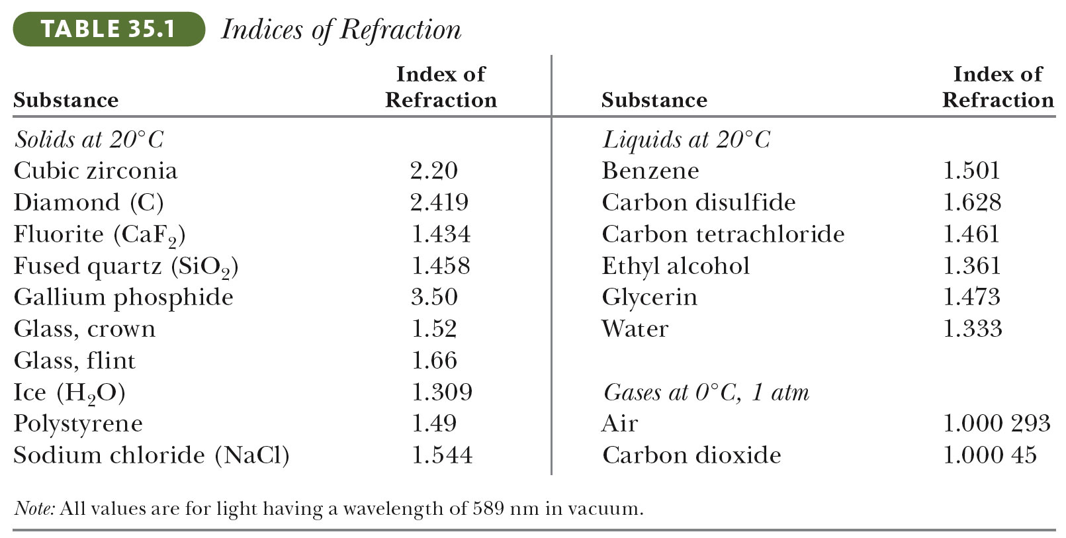
Note: All values are for light having wavelength λ = 589 nm in vacuum (yellow light).
i-clicker:
What is the speed of light in glass?
A) $1.0∙{10}^{8}$ m/s D) $2.5∙{10}^{8}$ m/s
B) $1.5∙{10}^{8}$ m/s E) $3.0∙{10}^{8}$ m/s
C) $2.0∙{10}^{8}$ m/s

Slide 16
Refraction and Snell’s law
When a ray of light travels through a transparent medium and encounters a second transparent medium, part of the light is reflected and part of the light enters the second medium.
The ray that enters the second medium changes direction; it is refracted.
The incident ray, the reflected ray and the refracted ray all lie in the same plane.
In the image below, which rays are refracted rays, and which are reflected rays?
i-clicker: If ray 1 is the incident ray, which rays in the image are refracted:
2, 5
3, 4
3, 5,
1, 2, 5,
None

Slide 17
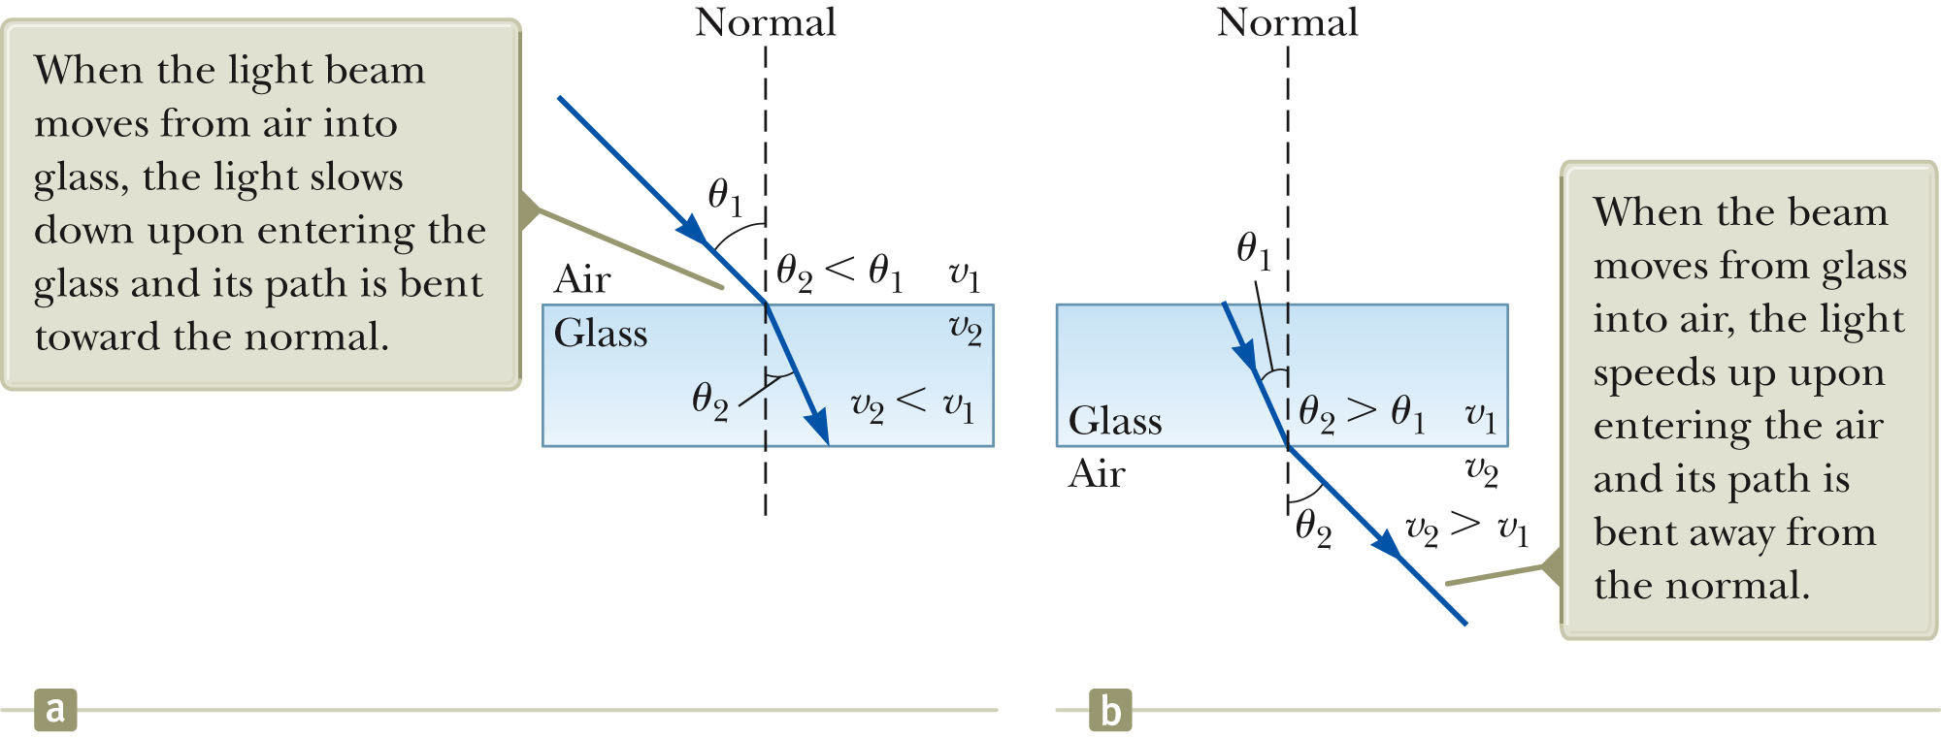
Refraction and Snell’s law
Snell’s law:
$$n_{1}sinθ_{1}=n_{2}sinθ_{2}$$
When light moves into a higher index of refraction medium, it slows down and bends toward the normal.
When light moves into a lower index of refraction medium, it speeds up and bends away from the normal.
(Derivation: From Huygens's principle, see extra slides).

Slide 18
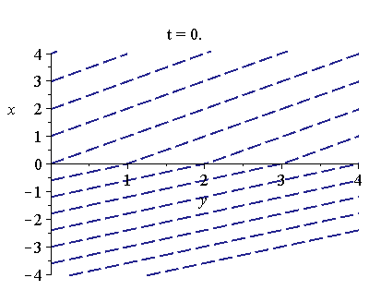
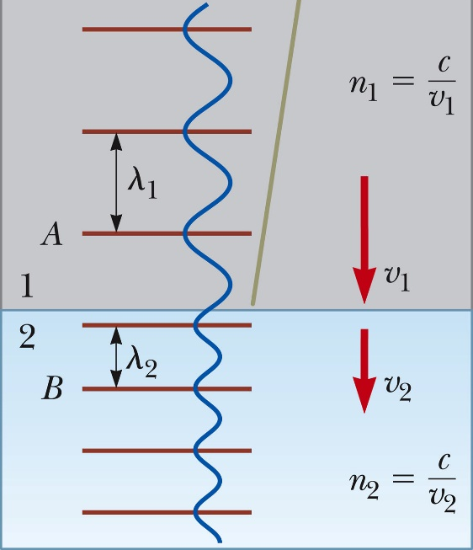
Illustration and summary of refraction
When light moves into an optically denser medium (index of refraction n₂ > n₁):
The speed of light gets reduced, $n_{1}c_{1}=n_{2}c_{2}$
The wavelength shortens, $n_{1}λ_{1}=n_{2}λ_{2}$
The light bends toward the normal (Snell’s law), $n_{1}sinθ_{1}=n_{2}sinθ_{2}$
The frequency stays the same, $f_{1}=f_{2}$
Vice versa for moving into less dense medium (lower index of refraction).

Slide 19
Snell’s Law: i-clicker
A light ray in air enters a region at an angle of 34°. After going through a layer of glass, diamond, water, and glass, and back to air, what angle will it be at?
A) 34° B) Less than 34° C) More than 34° D) This is too hard
34°
θ₂
θ₂
n₄ = 1.33
n₅ = 1.5
θ₃
θ₃
θ₄
n₆ = 1
θ₄
n₁ = 1
n₂ = 1.5
n₃ = 2.4
θ₅
θ₅
θ₆

Slide 20
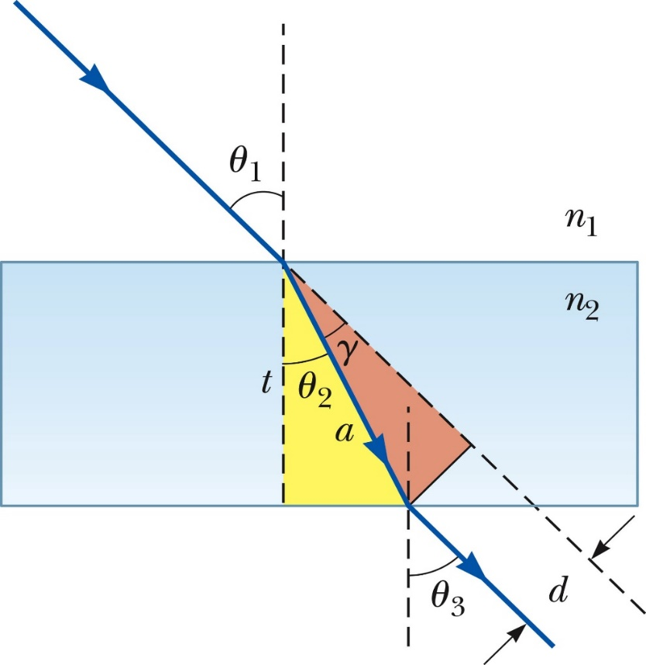
Two white board examples
When the light illustrated at right passes from air through the glass block, it is shifted laterally by the distance d.
If θ₁ = 30°, the thickness t = 2.00 cm, and n = 1.50, what is the value of d?
(From MCAT): If a ray is refracted from air into a medium with n = 1.47 at an angle of incidence of 5⁰, the angle of refraction is
0.059 B. 0.087
C. 0.128 D. 0.243

Slide 21
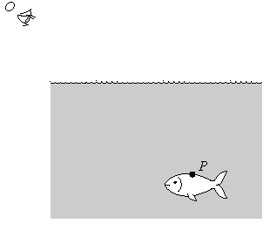
i-clicker
A fish swims below the surface of the water at P. An observer at O sees the fish at
a greater depth than it really is;
the same depth;
a smaller depth than it really is

Slide 22
Dark slide for demo

Slide 23
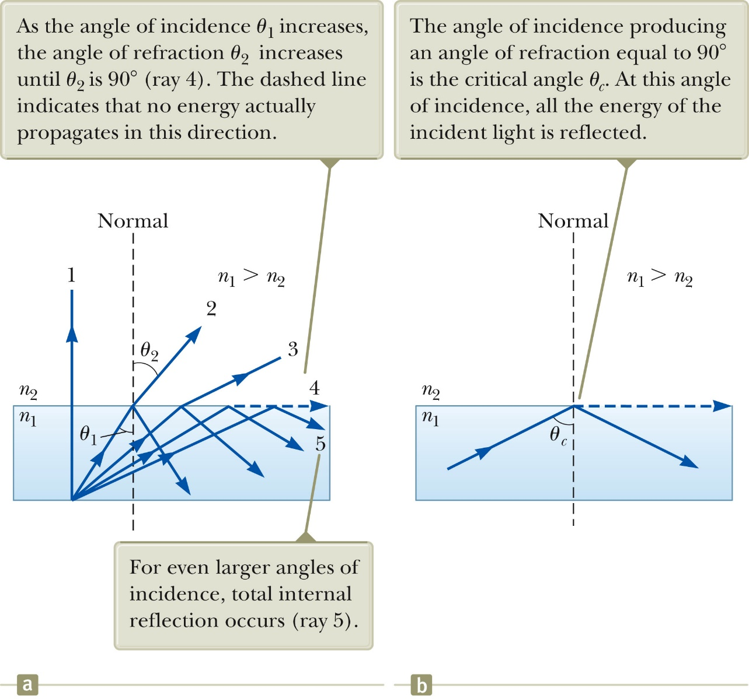
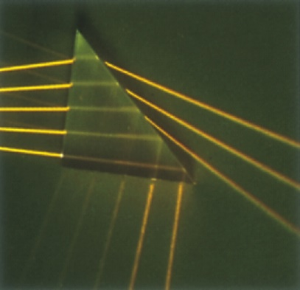
Total Internal Reflection
When light hits the interface between a dense and a less dense medium at an angle larger than the critical angle, it will be totally internally reflected; it will never enter the less dense medium
If θ_{i} > θ_{c} we only get reflected light
How many of the five incident rays are totally internally reflected at the glass-air interface?

Slide 24
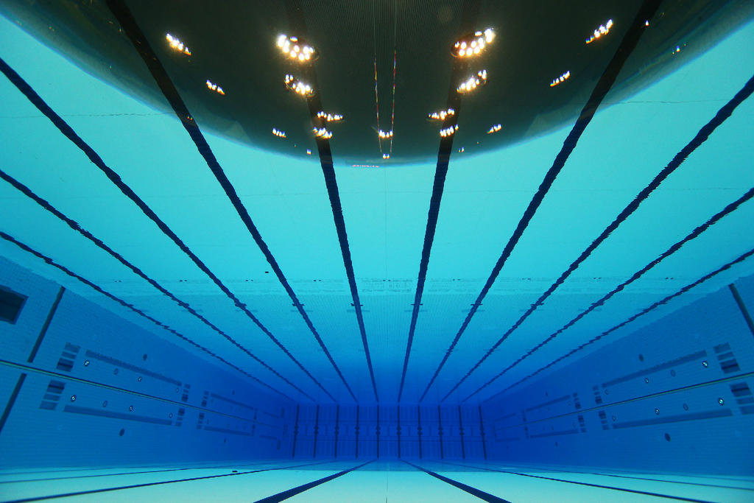
Total Internal Reflection
Test this out in the pool, and schematically explain the following image. When looking up from underneath the water:
If we look more in the forward direction (θ_{i} > θ_{c}), we see the bottom of the pool (total internal reflection)
If we look more in the upward direction (θ_{i} < θ_{c}), we see the ceiling/sky (refraction)
White board example:
Assuming you are right underneath the water surface, at what angle, θ_{c}, will the view change?
(What is the critical angle for the air-water interface?)

Slide 25
Total internal reflection application: Optical Fibers
Protective Jacket
Low n glass
High n glass
Light enters the high index of refraction glass
It totally internally reflects – repeatedly
Power can stay largely undiminished for many kilometers
Used for many applications
Especially in transmitting signals in high-speed communications – up to 40 Gb/s

Slide 26
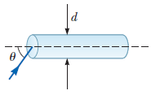
White Board example
Assume a transparent rod of diameter d = 4.00 µm has an index of refraction of 1.36. Determine the maximum angle θ for which the light rays incident on the end of the rod in the figure below are subject to total internal reflection along the walls of the rod. Your answer defines the size of the cone of acceptance for the rod.

Slide 27
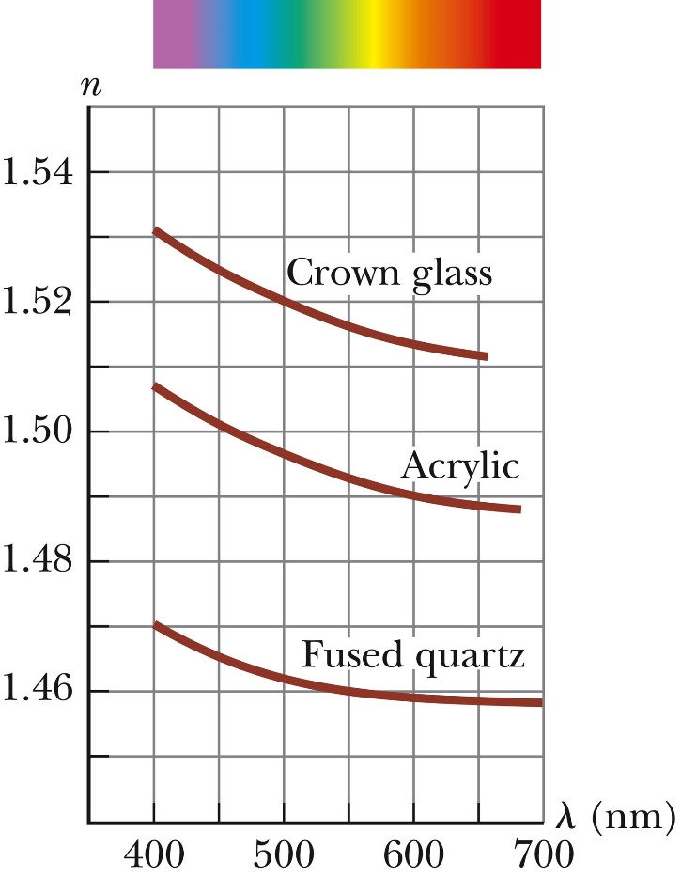
Dispersion
The speed of light in a material can depend on frequency
Index of refraction n depends on frequency
Its dependence is usually given as a function of wavelength in vacuum
Called dispersion
This means that different types of light bend by different amounts in any given material
For most materials, the index of refraction is higher for short wavelengths
Red Refracts Rotten
Blue Bends Best
Vacuum wavelength:
Frequency: 750 600 500 429 (THz)

Slide 28
Prisms
Put a combination of many wavelengths (white light) into a triangular dispersive medium (like glass); light gets split into its individual colors.
Prisms are rarely used in research
Diffraction gratings work better
Lenses (ch. 36) are a lot like prisms
They focus colors unevenly
Blurring called chromatic dispersion
High quality cameras use a combination of lenses to cancel this effect

Slide 29
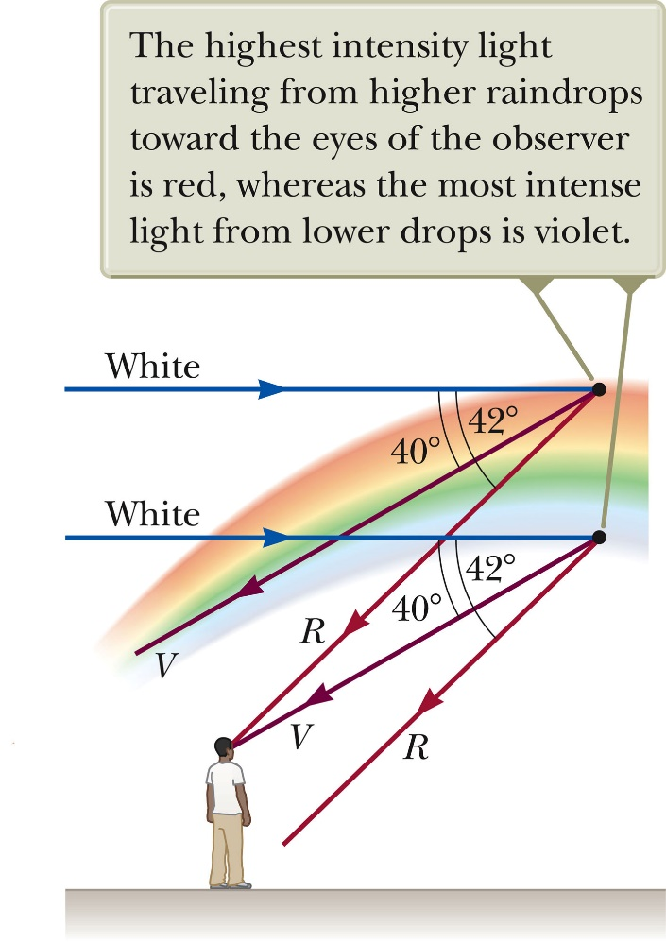
Rainbows
A similar phenomenon occurs when light reflects off the inside of a spherical rain drop
This causes rainbows
If it reflects twice, you can get a double rainbow
Red is bend the least and reaches the eye of the observer from higher up in the sky
Violet is bend the most and reaches the eye of the observer from lower in the sky.

Slide 30
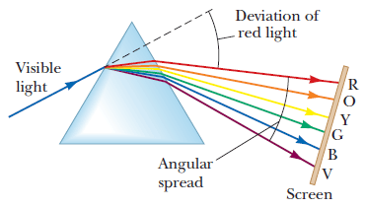
White Board example
The index of refraction for violet light in silica flint glass is 1.66, and that for red light is 1.62. What is the angular spread of visible light passing through a prism of apex angle 60.0° if the angle of incidence is 50.0°?

Slide 31
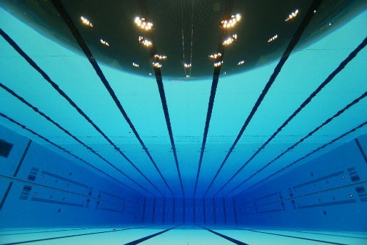
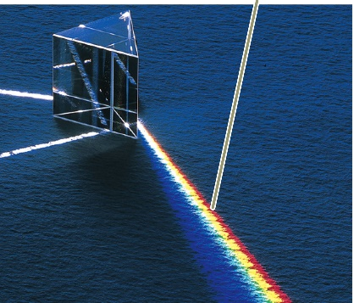
Review
Dual Nature of light: Wave & Particle
Energy of light (photon): $E=hf$
The speed of light in vacuum, c = 3.00·10⁸ m/s
In chapters 35 & 36 we will treat light as simple, straight, rays (can be done when features are larger than wavelength of light, $d≫λ$.
Reflection: incident angle = reflected angle: $θ^{′}=θ$
Refraction and Snell’s law: $n_{1}sinθ_{1}=n_{2}sinθ_{2}$, index of refraction $n=\frac{c}{v}$
Huygens’s Principle (wavelets and wave front)
Dispersion (index of refraction, n, depends on wavelength)
Total internal reflection

Slide 32
Extra Slides

Slide 33
Huygens’s principle
All points on a given wave front are taken as point sources for the production of spherical secondary waves, called wavelets, that propagate outward through a medium with speeds characteristic of waves in that medium. After some time has passed, the new position of the wave front is the surface tangent to the wavelets

Slide 34
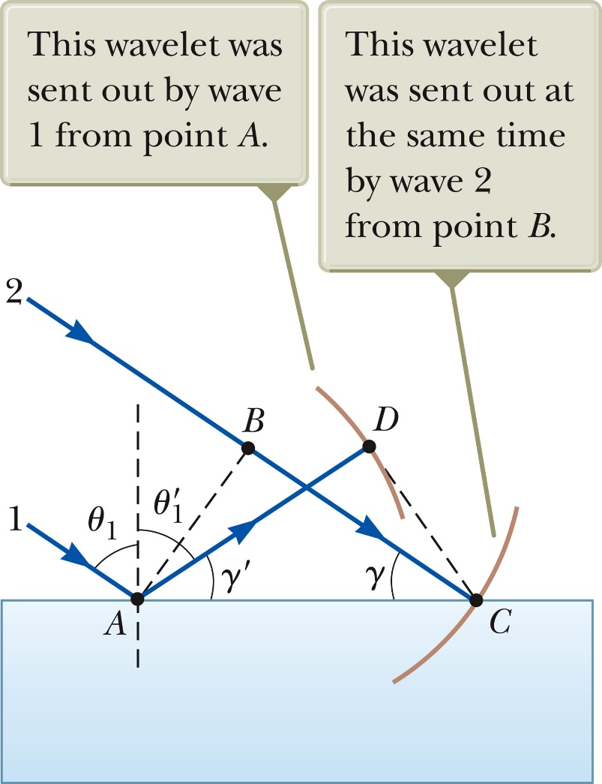
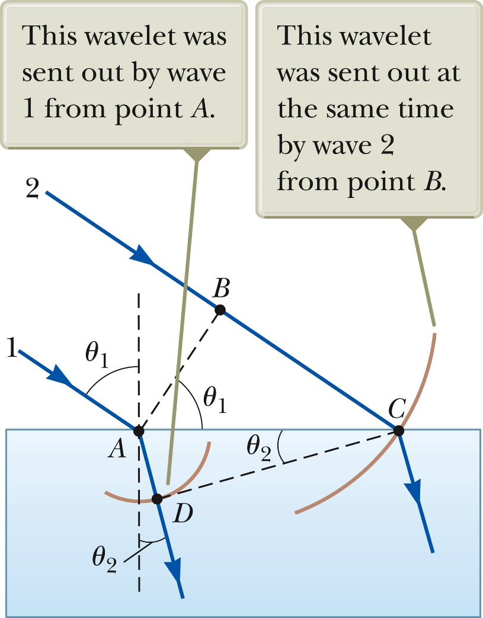
Huygens’s principle
Law of reflection Snell’s law

Slide 35
Light of wavelength 700 nm is incident on the face of a fused quartz prism (n = 1.458 at 700 nm) at an incidence angle of 75.2°. The apex angle of the prism is 60.0°.
(a) Calculate the angle of refraction at the first surface. (b) Calculate the angle of incidence at the second surface. (c) Calculate the angle of refraction at the second surface. (d) Calculate the angle between the incident and emerging rays.

Slide 36
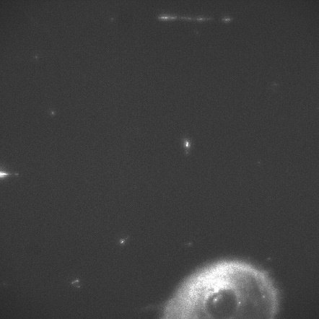
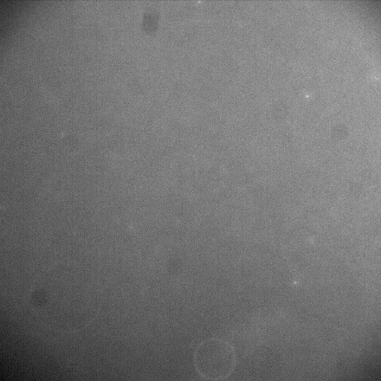
Prism-based TIR (total internal reflection) illumination
Distance above cover slip
Relative light intensity
132 nm
0.125
No signal (background) from molecules far from surface.
88 nm
0.25
Laser
44 nm
0.5
Only molecules close to surface will fluoresce
TIRF
No TIRF
Prism and cover slip
Microscope objective
TIRF is a technique to only excite fluorophores on/close to surface
Background noise is strongly reduced
n₁ …index of refraction of glass slide
n₂ …index of refraction of water
θ … incident angle
λ … wavelength of light
L. Peng et al. Microscopy Research & Technique (2007) 70, 372-81

Slide 37
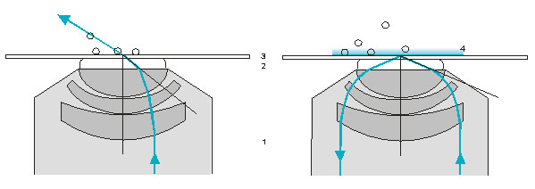
Objective-based TIRF illumination
Ray paths (schematic):
5
Angle of incidence smaller than the critical angle.
Total reflection 1: Objective,
2: Immersion oil n = 1.518,
3: Cover slip n = 1.518,
4: Evanescent field,
5: Mountant n = 1.33…1.38
www.zeiss.com
See applet and info at: http://www.olympusmicro.com/primer/techniques/fluorescence/tirf/tirfhome.html

Slide 38
Application: Single molecule FRET G. Bokinsky et al. “Single-molecule transition-state analysis of RNA folding” (2003) PNAS 100: 9302
The hairpin ribozyme:
The docking and undocking conformations and a single molecule FRET trace:
SA

